Slide 1

Insights into Walmart: A Deep Dive into Electronics Sales

Slide 2
Workflow
1) Gather Data
2) Data Cleansing
3) Data Modelling
4) Creating Reports
5) Publish to Power BI Service
6)Create Dashboards
7) Share

Slide 3
Walmart company Walmart Company
Customers can place orders for various products sold by the company online.
Company delivers the product in least possible time depending upon the customer's address.
Customers can choose either cash on delivery option or they can pay online while placing the order.
Company follows 10 days return policy.

Slide 4
Dataset
Dataset consists of 4 cv files that consist of sales data for 4 months,
1) January 2019
2) February 2019
3) March 2019
4) April 2019

Slide 5
Fields
Each CSV file consists of following columns;
Order ID: It can be used to uniquely identify each order, & in one order more than one products could have been ordered.
Product: Consists of Product name.
Quantity Ordered : Tells us about the quantity of given product ordered in a given order ID.
Price Each : Represents price of each unit of given product in a given
Order ID
Order Date: The date on which order was placed.
Purchase Address: Customer's Address

Slide 6
Questions
Create a PBI report to answer these questions:
1) Top/Bottom 5 products by sales.
2) Sales by regions
3) All details about the products ordered in a given order.
4) Number of orders by time of day.
5) Number of orders by date.
6) Sales by month
7) Number of orders by month
8) Top/Bottom 5 products by cost.
9) Five Most & least ordered products.
10) Relationship between sales and quantity ordered.

Slide 7
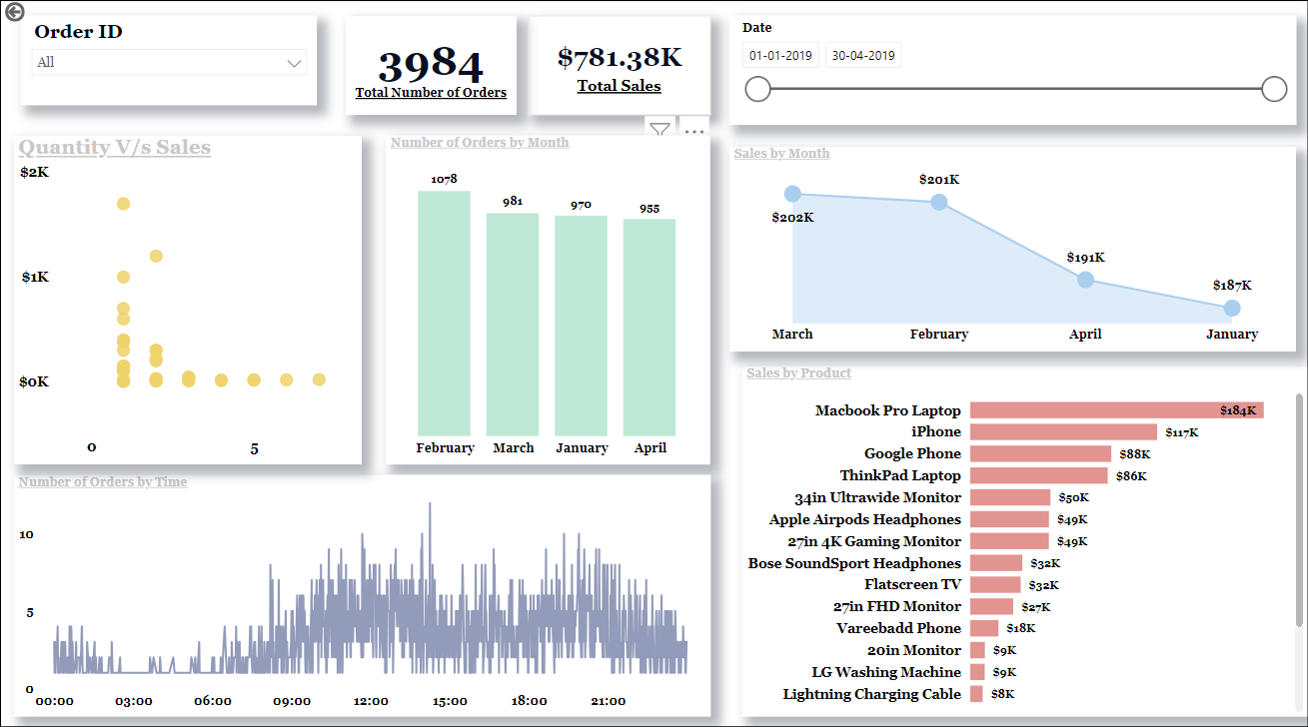
Walmart Sales Insights

Slide 8
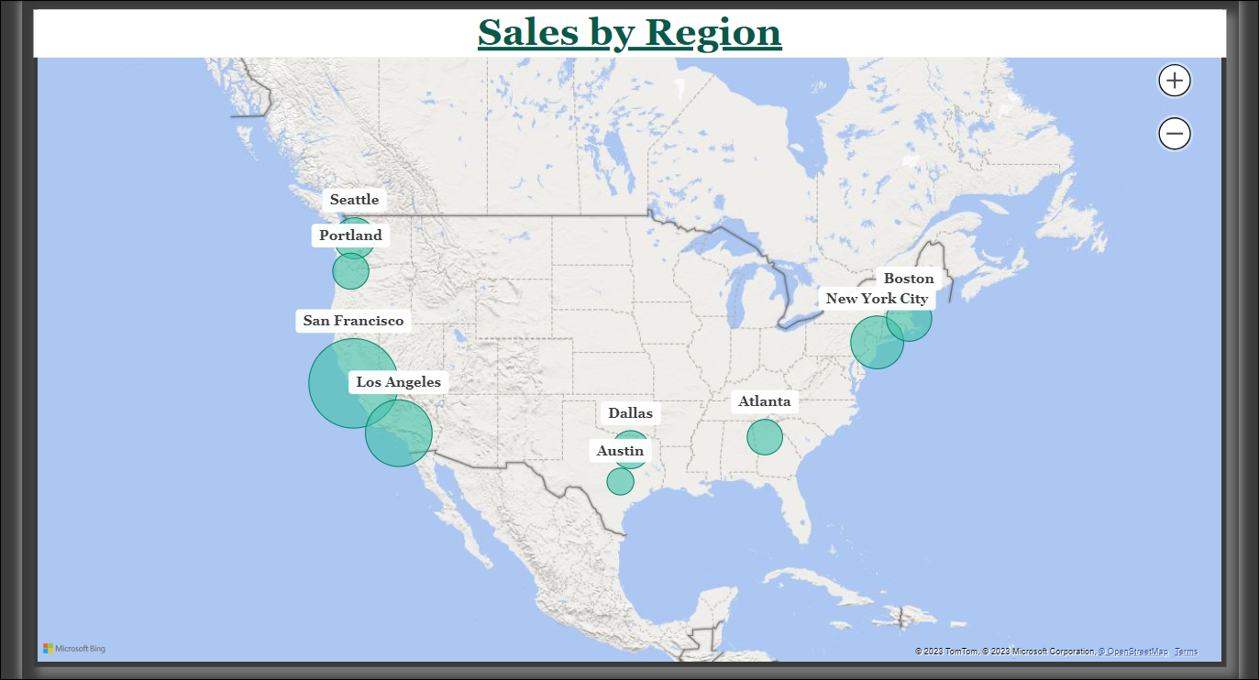

Slide 9
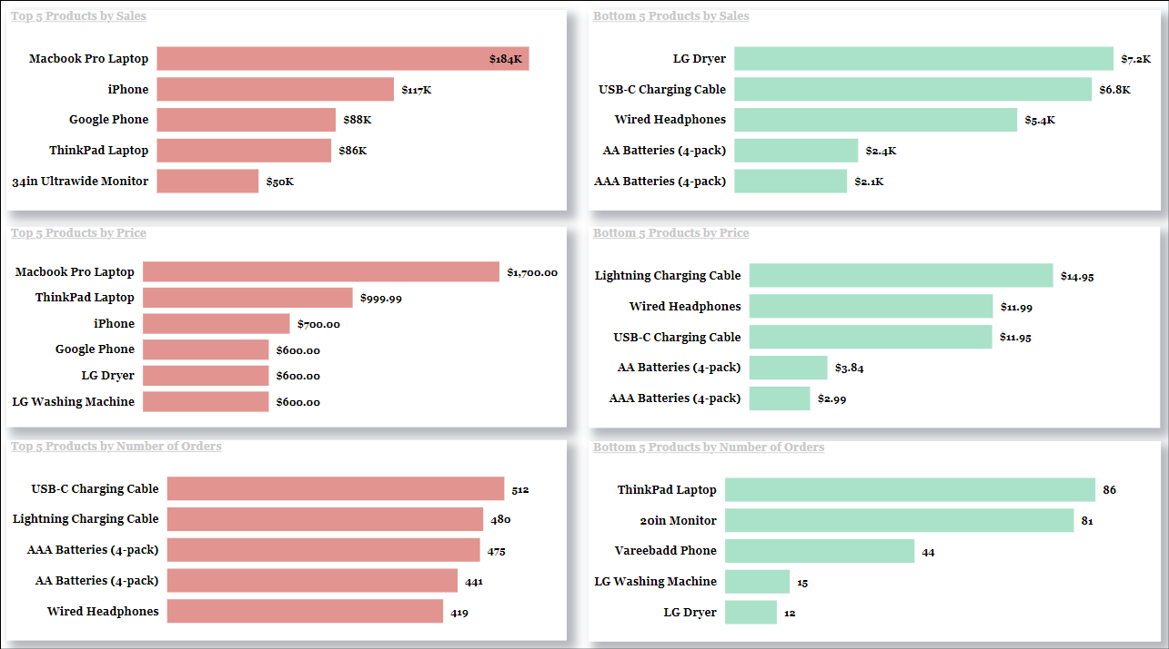

Slide 10
